Slide 1

HPE Advanced Cybersecurity Threat Hunting Solution Combining Graph Analytics and memory driven computing
Ashish Kumar
01 20 2020

Slide 2
Key Challenges in Cyber Threat Hunting
Mean Time to Detection (MTTD) driven up by massive data and compute capability gaps
CYBER THREAT HUNTING CHALLENGES
AREAS OF FOCUS
SOLUTION OPTIONS
Alternative data modeling approach for rapid access and flexibility
Employ Scale-up architecture for unified analysis with time and performance benefits
Develop data pipeline to preserve current processes but handle desired volume
Augment SIEM with additional discovery methods
Process and technical challenges in timely and complete access to security information
Hybrid approach using big data techniques along with existing SIEM solutions
Traditional data modeling and access technologies rigid and non-performant
High performance graph analytics
Scale-out compute not effective in addressing massive scope of large enterprise network graph
Memory-Driven Computing (MDC)
Rule-based SIEM has limited visibility for all possible threat vector discovery
Additional discovery using pattern matching and anomaly detection

Slide 3
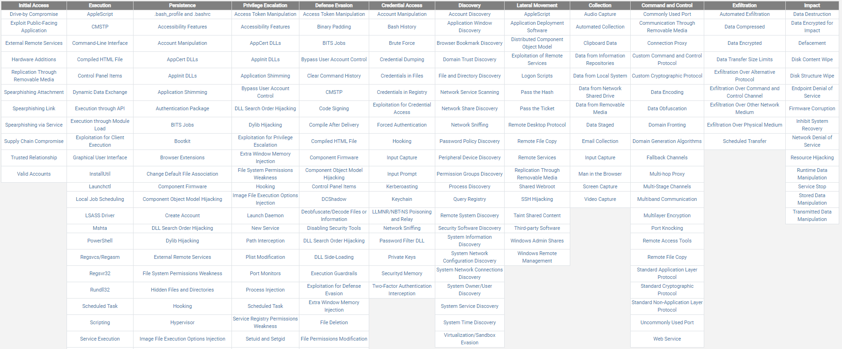
How Long Does it Take to Scan for Known Threats?
MITRE ATT&CK Matrix
Notes:
Need to look at all of these (1,500) several times a day - are you?
This point isn't obvious to people - one of the ways of solving security problems and staffing issues is to encode the Mitre patterns - no way to do this today. Looking for development partners to help.
No technology today to scan for this in a repeatable fashion multiple times a day, much less in a week.

Slide 4
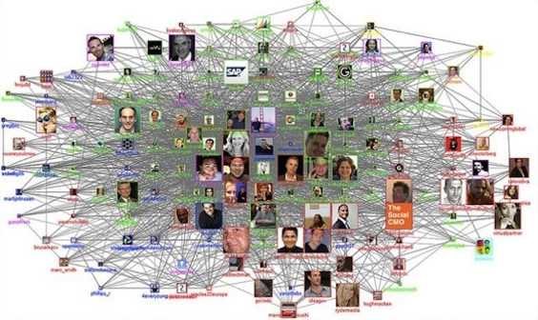

The Opportunity
Reduce Mean Time to Detection (MTTD) and dwell time with proactive threat hunting
Threat pattern matching and machine learning-based anomaly detection
Rapidly identify hard-to-detect patterns such as lateral movement
Increase the number of potential threats identified while decreasing false positives
Attack threats “left-of-boom”
Limit blast radius and dwell time through faster time to detect
Reduce overall risk associated with high priority / profile cyber events
Enabled through advanced analytic and compute capability
Deploy next generation graph analytics to model the massive complexity of an enterprise network graph
Leverage advanced data engineering with big data techniques to expand data coverage in cyber threat hunting
MDC-optimized analytics to execute an order of magnitude more network threat queries in a given time period
In Memory Analytics
Data Lake

Slide 5
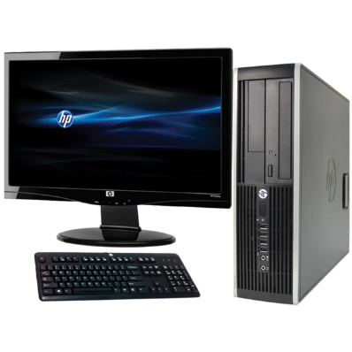
Example: Cyber-attack - RDP (Lateral Movement)
Given a map of the netflow over time:
Find any situation where Node A reboots…
…then a specific program launches then Node A RDP’s to Node B…
…then within a short time window that node goes through the same process to RDP’s to Node C.
4. Privilege Escalation
5. Program Launch
Privilege Escalation
Program Launch
3. RDP Netflow
6. RDP Netflow

Slide 6
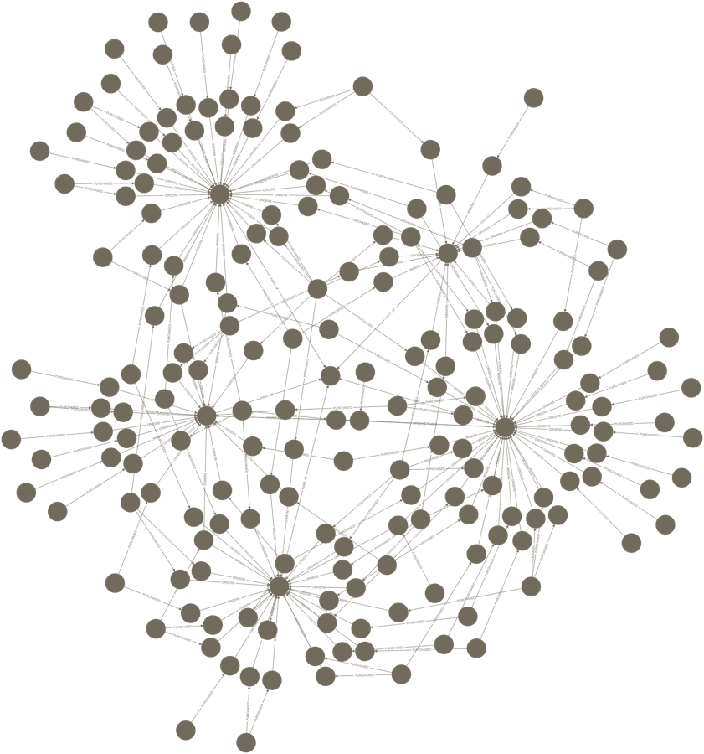
Finding Lateral Movement: The “Needle in the Haystack”
Similarity - “Sub-graph Isomorphism”
Intrusion Graph

Slide 7
The Relational approach
SELECT NetFlow1.SourceIP, NetFlow1.DestIP, NetFlow1.time, NetFlow2.DestIP, NetFlow2.time
FROM Netflow NetFlow1, Netflow NetFlow2, HostEvents hijack1, HostEvents hijack2,
HostEvents privEsc1, HostEvents privEsc1
WHERE NetFlow1.DestIP = NetFlow2.SourceIP
AND privEsc1.HostIP = NetFlow1.SourceIP
AND hijack1.HostIP = NetFlow1.SourceIP
AND privEsc2.HostIP = NetFlow2.SourceIP
AND privEsc2.HostIP = NetFlow2.SourceIP
// make sure vertices are distinct
AND NetFlow1.SourceIP <> NetFlow1.DestIP
AND NetFlow1.SourceIP <> NetFlow2.DestIP
AND NetFlow2.SourceIP <> NetFlow2.DestIP
// make sure the edges are what we are looking for
AND privEsc1.eventID = 4688
AND (privEsc1.processName = "Proc336322.exe" OR privEsc1.processName = "Proc695356.exe")
AND hijack1.eventID = 4688 AND hijack1.processName = "Proc249569.exe"
AND privEsc2.eventID = 4688
AND (privEsc2.processName = "Proc336322.exe" OR privEsc2.processName = "Proc695356.exe")
AND hijack2.eventID = 4688 AND hijack2.processName = "Proc249569.exe"
// Check time constraints on the overall pattern
AND NetFlow1.time <= NetFlow2.time
AND NetFlow2.time - NetFlow1.time < 3600
// Check time constraints on step from A to B
AND privEsc1.time <= hijack1.time
AND hijack1.time <= NetFlow1.time
AND NetFlow1.time - hijack1.time < 180
AND NetFlow1.time - privEsc1.time < 480
// Check time constraints on step from B to C
AND privEsc2.time <= hijack2.time
AND hijack2.time <= NetFlow2.time
AND NetFlow2.time - hijack2.time < 180
AND NetFlow2.time - privEsc2.time < 480
Netflow Table
SourceIP | DestIP | Protocol | … | Time
14.34.55.1 | 14.99.3.95 | RDP | … | 12:03:34
14.99.3.95 | 14.72.54.9 | RDP | … | 12:09:18
HostEvents Table
HostIP | … | EventID | ProcessName | Time
14.34.55.1 | … | 4672 |  | 12:00:54
14.34.55.1 | … | 4688 | Proc336322.exe | 12:01:14
14:99:9:95 | … | 4672 |  | 12:05:23
14:99:9:95 | … | 4688 | Proc336322.exe | 12:06:47
Too complex
Too much data
Takes too long
Doesn’t address worst issues

Slide 8
Graph Analytics
Relational
Property Graph
Privilege
Escalation
Netflow Table
SourceIP | DestIP | Protocol | … | Time
14.34.55.1 | 14.99.3.95 | RDP | … | 12:03:34
14.99.3.95 | 14.72.54.9 | RDP | … | 12:09:18
Nodes
HostIP: 14.99.9.95
Edges
HostEvents Table
Privilege
Escalation
RDP Netflow
RDP Netflow
HostIP | … | EventID | ProcessName | Time
14.34.55.1 | … | 4672 |  | 12:00:54
14.34.55.1 | … | 4688 | Proc336322.exe | 12:01:14
14:99:9:95 | … | 4672 |  | 12:05:23
14:99:9:95 | … | 4688 | Proc336322.exe | 12:06:47
Program
Launch
HostIP: 14.34.55.1
HostIP: 14.72.54.9
Program
Launch
Relational is about things – relationships are implied
Graph is about relationships – connections are explicit
Notes:
Flow: We understand you have a problem - you have lots and lots of security events every day that need to be processed. Tools are not sufficient because they are traditional Splunk / SQL and relational problems. Because nodes are limited in size, the queries need to be spread across an array of nodes. Our solution is a combination of graph and MDC. What do we mean by that, and why is it superior?

Slide 9
The problem with Traditional Graph…
Does not scale out well
Server1
Server2
Server3

Slide 10
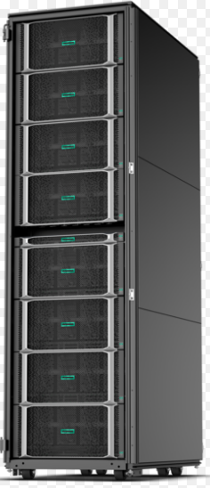

Solution: Cyber security THREAT HUNTING accelerator
HPE SUPERDOME FLEX
TROVARES xGT
Memory Driven Computing today
Unparalleled scale 4-32 sockets
Up to 48TB memory today
96TB memory possible
Ultra-fast memory fabric
Keep pace with evolving business demands
Unique modular 4-socket building block
Linear Application Scalability
Open management and hard partitioning for hybrid IT consumption
Find the Known Faster.
Highly-parallelized graph
Analytics search engine
RESERVOIR LABS ENSIGN
Find the Unknown.
Machine learning graph
analytics

Slide 11

Trovares xGT Graph Search Engine
Seattle-based start-up founded to commercialize work done on behalf of the US DOD.
Founders from Cray and the Pacific Northwest National Laboratory (PNNL)
In memory, high performance Graph Engine
Leveraging supercomputing techniques for parallelism and search optimization
Differentiated Sub Query Isomorphism makes it a unique fit for Network Threat detection

Slide 12


xGT cyber threat Search process
xGT
Data Lake
Results
Ingest
Query
Query
Query
Query
Query
Pbytes Of
Customer Data
Tbytes of Memory
Visualization and other downstream analytics
Search
Competition
Cannot Get Here

Slide 13

Graph Analytics with Machine Learning: Reservoir Labs Ensign
Core analytics based on “tensor decompositions”
Computationally expensive and sophisticated mathematical methods
Sparse irregular computations add complexity to performance scaling
Unsupervised machine learning
Patented and patent-pending techniques for computation and communication optimizations
Successful application areas
Cyber security
Activity-based intelligence

Slide 14
Early Results with Trovares and Reservoir Labs on SDFlex
4+ hours to
14.8 seconds
1000x improvement on
Threat Detection scan
5+ hours to
45 seconds
400x improvement on
Vulnerability Assessment scan
Notes:
Vulnerability scan improved from 5 hours to 1 hour running on Superdome Flex, unmodified and untuned. With minimal Linux kernel tuning, the results further improved from 1 hour to 20 minutes (still with no application tuning to leverage the scale-up memory space).

Slide 15



Deployment Architecture
Security Information & Event Management (SIEM)
Network Data
Data Sources
Endpoint Data
HPE cyber threat hunting with Graph Analytics and Machine Learning
Data lake
Threat Intelligence
Highly scalable search for known threats
+
machine-learning enabled hunting for anomalous behaviors
Data ingest & preparation
Environment Information

Slide 16
Cybersecurity Graph analytics - reference Architecture
Existing Cybersecurity Analytics
Augmenting
Advanced Cybersecurity Analytics
Windows
Event
Log
Netflow
Log
Windows
Event
Log
Netflow
Log
Windows
Event
Log
Netflow
Log
. . . .
Lateral
Threat
Exfiltration
Command & Control
Privilege
Escalation
Identify
Protect
Detect
Respond
Recover
DNS
Log
. . . .
DHCP
Log
Windows
Event
Log
Netflow
Log
DNS
Log
DHCP Log
DNS
Log
DHCP
Log
DNS
Log
DHCP
Log
Cybersecurity
Life-Cycle
(NIST)
Data Lake
Splunk
xGT In-Memory Parallel Search Engine
xGT Property Graph Data Analytics Engine`
HPE Apollo 2000
HPE Apollo 2000
HPE Apollo 4200
16 Socket
Max 12TB
Base - PoC
32 Socket
Max 24TB
Standard - Prod
32 Socket
Max 48TB
Enterprise - Prod

Slide 17
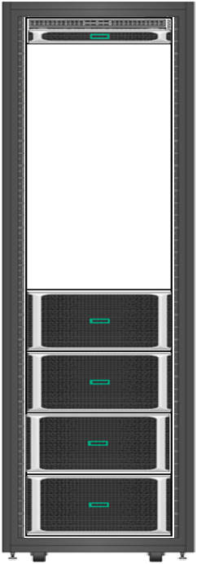
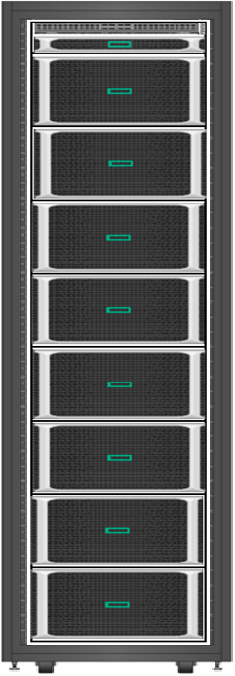
Cybersecurity Graph Analytics – reference configuration
Cybersecurity Analytics
Threat Detection Techniques
Lateral Threat Detection
Exfiltration
Command and Control
Privilege Escalation
xGT Cybersecurity Analytics Toolkit
Jupyter Notebook
Python 3.0
Per Chassis Configuration
28cores/socket = 448 cores
Processor : Cascade Lake . Xeon-Platinum 8280
Per Chassis - 16 half-height PCIe slots
3 TB DDR4 RAM per Chassis = 24 * 128GB
4 * 1.9 TB 2.5” SSD per Chassis ( For O/S + Temp files )
8 * 1.6TB / 3.2TB NVMe Card
1 * HPE Eth 10/25Gb 2p 631SFP28 Adptr per Chassis
12 Gb SAS Storage Controller
RHEL 7.6
ToR Switch
1*25GbE Switch – HPE FlexFabric 5950 48SFP28+ Switch
Monitoring/Management
1U External RMC
HPE Foundation Software ( Data Collector Daemon – Agentless Service )
HPE ISSP – InfiniteStorage Software Platform (R-Pool - HPE XFS)
 | Base Configuration | Standard Configuration | Enterprise Configuration
Scaling Cyber Graphs (Typical) | 3B Vertices / 30B Edges / 300B Properties | 6B Vertices / 60B Edges / 600B Properties | 6B Vertices / 60B Edges / 600B Properties
Total Sockets | 16 | 32 | 32
Total Cores | 448 | 896 | 896
Total Memory (TB) | 12 | 24 | 48
Total Storage NVME (TB) | 50 | 100 | 200

Slide 18
Joint Development Program Opportunity
High-Touch, Joint
Development program
Working closely with HPE engineering,
Trovares and Reservoir Labs
Your Data, Your Challenges,
Your Success Criteria
10-week engagement aimed at proving the concept
Tied back to a measurable return on investment
Based on experiences in your market segment
Customer Gives:
Data Sources
Cybersecurity Engineer (hours TBD)
Use Cases and Success Criteria
HPE Field Gives:
PoC gear and Program Manager
HPE Corporate, Trovares and Reservoir Labs Give:
Staff augmentation (query dev, performance optimization)
Discovery Workshop (with FSI Cyber expert)
Customer Gets:
White glove support
Validation of the solution (with their data and use cases) and business case support
Discounted hardware / software
Upon Meeting Success Criteria
Intent to purchase PoC hardware and software
Privately referenceable within your “community”
Intent to pursue production deployment

Slide 19
Summary & Next Steps
High dwell time and Mean Time to Detection of Advanced Persistent Threats (APT) is a major concern for cybersecurity teams
Proactive threat hunting is an effective tool in combating APTs
61% of organizations surveyed reported at least 11% improvement in overall security posture using threat hunting*
71% of organizations surveyed indicate technology is the first or second focus of their threat hunting resources*
HPE’s MDC enabled advanced graph analytics solution is a powerful tool for threat pattern matching and machine-learning based anomaly detection
HPE seeks a joint development partnership to advance the solution capabilities through application in large enterprise environment
Next Steps…..
*SANS 2019 Threat Hunting Survey: The Differing Needs of New and Experienced Hunters (Oct 2019)

Slide 20
Thank You

Slide 21
Memory Driven Computing in context
Physical Server
Physical Server
Physical Server
CPU
Local DRAM
CPU
Local DRAM
Local NVM
NVM
CPU
Local DRAM
CPU
Local DRAM
CPU
Local DRAM
NVM
Local NVM
Local NVM
Network
Network
Coherent
Interconnect
Network
Communications and Memory Fabric
Physical Server
Physical Server
CPU
Local DRAM
CPU
Local DRAM
NVM
CPU
Local DRAM
Local NVM
NVM
Local NVM
CPU
Local DRAM
CPU
Local DRAM
Local NVM
Fabric Attached Memory Pool
Shared Nothing
Shared Something
Shared Everything
Large collections of servers with large pools of fabric-attached memory enable new workloads

Slide 22
Background
Need a graphic which includes MDC, graph analytics & ML
Lead with the customer’s problem.
What Threat hunting does for the customer
What are the challenges
The opportunity & gap
Joint development proposal
HPE is exploring new solutions enabled by Memory Driven Computing (MDC)
MDC will create clusters of servers with a large pool of fabric attached memory
This will enable classes of work that are difficult on todays architectures
We have identified an unique capability for network threat detection which could be delivered today
CPU
CPU
Fabric Attached Memory
CPU
CPU
CPU

Slide 23
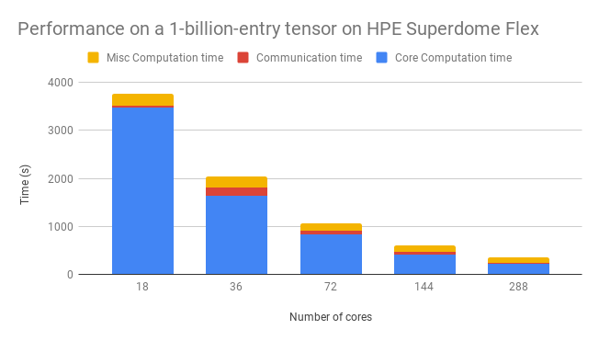
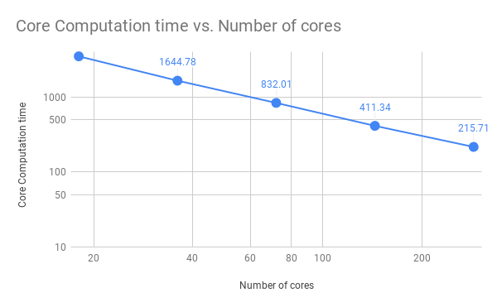
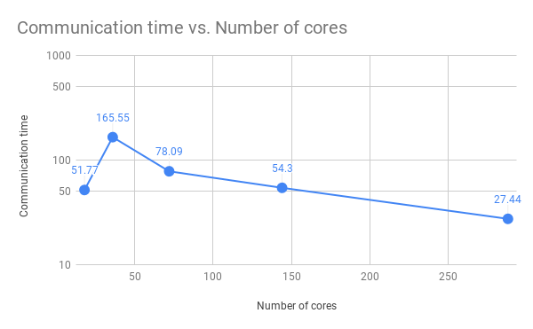
Scaled-up results with HPE SDFX 16-skt 6154 18 core processors
10x improvement
Preliminary Results – HPE Confidential - NDA Required

Slide 24
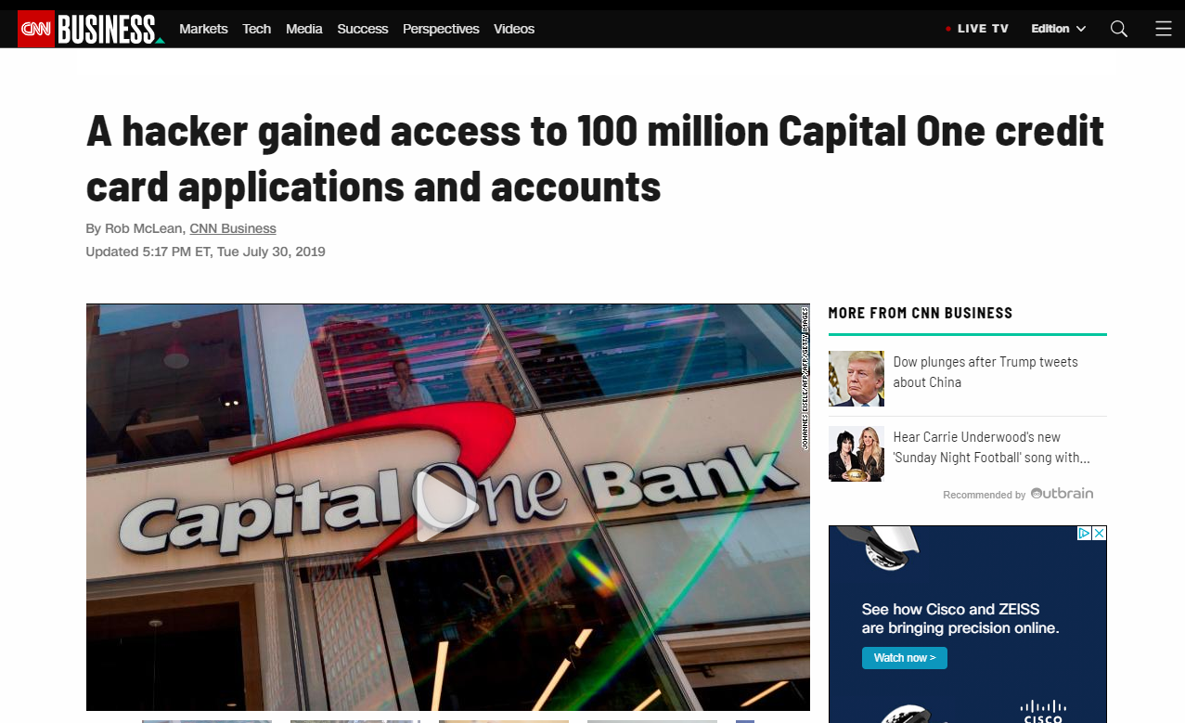
Cyber Security Threats
Global enterprises are subject to 100’s of thousands of attacks per day
Certain attack patterns (e.g. lateral movement) are seemingly impossible to detect (in time / at all).
“We spend our lives trying to find it” – Global Enterprise CISO
90%+ of red teams operate undetected inside global networks for weeks / months *
“The Financial Services Sector represents a vital component of our nation's critical infrastructure… an increase in the number and sophistication of cyberattacks demonstrate the wide range of potential risks facing the sector.”
- US Homeland security
* According to global FSI CISOs

Slide 25

FSI Sector Includes the Largest, Richest Attack Surfaces
300x greater ¹
Frequency of incidents
$336 ²
Cost per record
28% ³
Customers left their bank as a result
1 -5 Days ⁴
Time to execute full scan for known threats
Notes:
(1) Muncaster, P. (2015, June 24). Finance Hit by 300 Times More Attacks Than Other Industries. Retrieved from https://www.infosecurity-magazine.com/news/banks-hit-300-times-more-attacks/
(2) IBM. (2017). 2017 Ponemon Cost of Data Breach Study. Retrieved from https://www.ibm.com/security/data-breach
(3) Identity Theft Resource Center (ITRC). (2016, October 17). Identity Theft: The Aftermath (Rep.). Retrieved from http://www.idtheftcenter.org/images/page-docs/AftermathFinal_2016.pdf
(4) According to confidential customer interviews

Slide 26
How do organizations address this today?

Slide 27

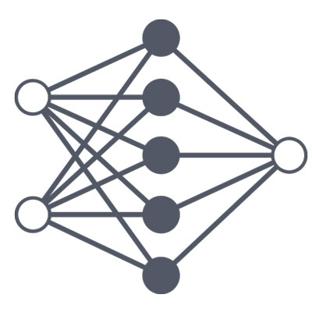
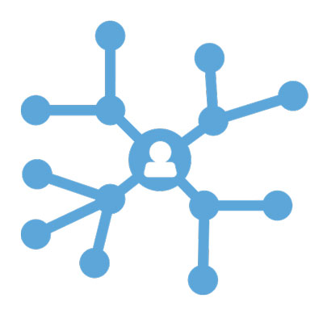

Examples of graph analytics techniques
Connectivity Analysis
Community Detection
Find and compare connectivity across graphs
Examples:
Find weaknesses in a power grid
Search for linkages between communities of people
Find and compare connectivity across graphs
Examples:
Determine clusters of interacting people in social media
Identifying disease modules from networks of proteins/genes
Centrality/Importance Analysis
Path Analysis
Identify the most central entities in the graph
Examples:
Influencer marketing
Page rank
Identify paths between 2 nodes in a graph
Examples:
Logistics route optimization
Determining health risk factors

Slide 28
Cyber Security Threat Hunting Accelerator
Anomaly Detection Pattern Matching
Unknown Threats Known Threats
Existing SIEM / Data Lake
Machine Learning
In-memory Graph Analytics
Fast ingest
Scale-up Memory-Driven Computing

Slide 29
Memory Driven Computing in context
Physical Server
Physical Server
CPU
Local DRAM
Local NVM
CPU
Local DRAM
CPU
Local DRAM
Local NVM
Local NVM
Network
Coherent
Interconnect
Network
Physical Server
CPU
Local DRAM
Local NVM
CPU
Local DRAM
CPU
Local DRAM
Local NVM
Local NVM
Shared Nothing
Shared Everything

Slide 30
Temporal Triangle Benchmark
Find all subgraphs where A connects to B then B connects to C then C connects to A within a given time window
Notes:
Reference : https://datasets.trovares.com/synthetic/TT/index.html

Slide 31
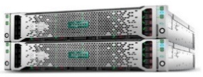
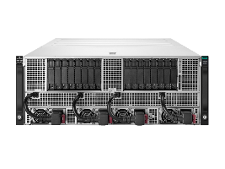
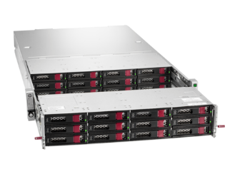
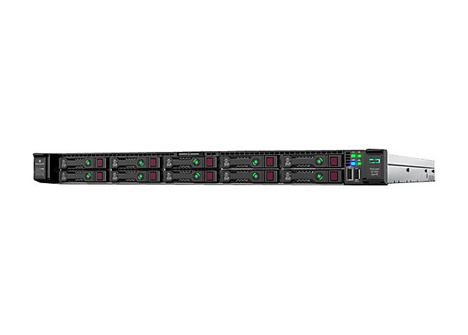
HPE’s Elastic Platform for Analytics
Bringing Big Data, Fast Data, AI and Memory Driven Computing together
“Big Data/Fast Data”
Analysis of data at rest and in motion
“MDC”
Deep Learning/Machine Learning
“AI”
Deep Learning/Machine Learning
HPE Reference Architecture for analytics
Separates compute and software defined storage
Allows best of breed infrastructure
Allows MDC to efficiently share large datasets with big data and AI
Large datasets can be stored and processed on scale out infrastructure
Subsets of data can be pulled into MDC/Graph memory quickly
MDC/Graph results can be persisted with other
Scale out streaming and batch data processing
Spark, Mapreduce, Kafka, Flink, Akka, etc
Dense compute such as Apollo 2000
In memory analytics
Trovares, Reservoir Labs, Hana, etc.
Large shared memory such as Superdome Flex
Deep learning
Tensorflow, Caffe, Torch, etc
GPU Optimized such as Apollo 6500
Network Block (High speed fabric – 100Gbs)
Data Storage
Capacity Storage
Performance Storage
Distributed Filesystems and Object
HDFS, MaprFS, Scality, etc
Capacity optimized LFF servers such as Apollo 4200
Key Value Stores, NoSqls, Columnar High Performance
Cassandra, Hbase, Kudu, WekaIO, etc
NVME Loaded servers such as DL360

Slide 32
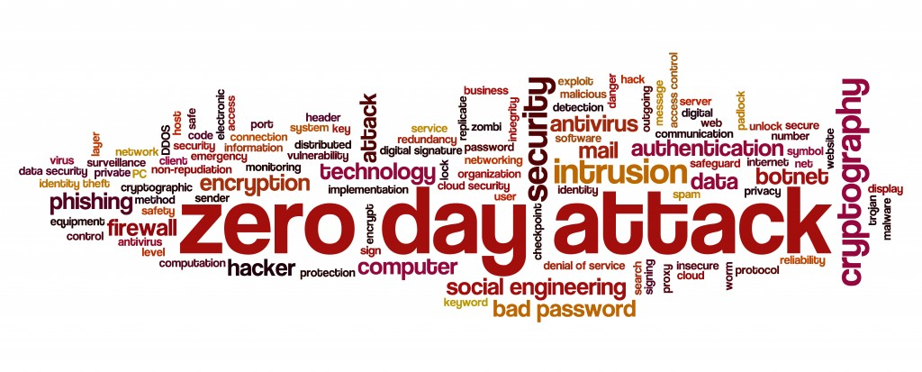
Next: Zero Day scanning
Notes:
Goal, through machine learning model development and training, is to be able to effectively implement zero day attack scanning

Slide 33


Typical Deployment
Windows
Event
Log
Windows
Event
Log
Windows
Event
Log
Collectors
Engineering
Netflow
Log
Netflow
Log
Netflow
Log
Access hundreds of threats per day
Call Centers
DNS
Log
Data Lake
DNS
Log
DNS
Log
Credit Card Processing
Data Lake
DHCP
Log
DHCP
Log
DHCP
Log
Production

Slide 34
Windows
Event
Log
Collectors
Windows
Event
Log
Windows
Event
Log
Engineering
HPE cyber threat hunting with Graph Analytics and Machine Learning
Netflow
Log
Netflow
Log
Netflow
Log
Highly scalable search for known threats
+
machine-learning enabled hunting for anomalous behaviors
Call Centers
Data ingest & preparation
DNS
Log
DNS
Log
DNS
Log
Data Lake
Data Lake
Credit Card Processing
DHCP
Log
DHCP
Log
DHCP
Log
Production

Slide 35
Comcast PoC Configuration
PCIs Slot 1
PCIs Slot 5 ( NVMe 1.6 TB
PCIs Slot 9 (NVMe 1.6 TB)
PCIs Slot 13
p1n1
p1n1
PCIs Slot 2
PCIs Slot 6 (NVMe 1.6 TB)
PCIs Slot 10 (NVMe 1.6 TB)
PCIs Slot 14
Chassis #1
p1n1
p1n1
PCIs Slot 3
PCIs Slot 7 (NVMe 1.6 TB)
PCIs Slot 11
PCIs Slot 15
PCIs Slot 4
PCIs Slot 8 (NVMe 1.6 TB)
PCIs Slot 12
PCIs Slot 16
BPS0
BPS1
BASE I/O or BMC
ASIC FAN
BPS 2
BPS 3
PCIs Slot 1
PCIs Slot 5 ( NVMe 1.6 TB
PCIs Slot 9 (NVMe 1.6 TB)
PCIs Slot 13
p1n1
p1n1
Subnet1
bond0
PCIs Slot 2
PCIs Slot 6 (NVMe 1.6 TB)
PCIs Slot 10 (NVMe 1.6 TB)
PCIs Slot 14
Chassis #2
p1n1
p1n1
Bond mode = round robin
PCIs Slot 3
PCIs Slot 7 (NVMe 1.6 TB)
PCIs Slot 11
PCIs Slot 15
PCIs Slot 4
PCIs Slot 8 (NVMe 1.6 TB)
PCIs Slot 12
PCIs Slot 16
BPS0
BPS1
BASE I/O or BMC
ASIC FAN
BPS 2
BPS 3
PCIs Slot 1
PCIs Slot 13
p1n1
p1n1
PCIs Slot 5 ( NVMe 1.6 TB
PCIs Slot 9 (NVMe 1.6 TB)
PCIs Slot 2
PCIs Slot 14
Chassis #3
Subnet2
bond1
p1n1
p1n1
PCIs Slot 6 (NVMe 1.6 TB)
PCIs Slot 10 (NVMe 1.6 TB)
PCIs Slot 3
PCIs Slot 7 (NVMe 1.6 TB)
PCIs Slot 11
PCIs Slot 15
Bond mode = round robin
PCIs Slot 4
PCIs Slot 8 (NVMe 1.6 TB)
PCIs Slot 12
PCIs Slot 16
BPS0
BPS1
BASE I/O or BMC
ASIC FAN
BPS 2
BPS 3
Install hpe-auto-config ( part of HPEFS )
Use persistent naming convention as per the superdome-flex admin guide
https://support.hpe.com/hpesc/public/docDisplay?docId=a00038167en_us
Perform mapping of chassis & nic before performing the bonding.
PCIs Slot 1
PCIs Slot 13
p1n1
p1n1
PCIs Slot 5 ( NVMe 1.6 TB
PCIs Slot 9 (NVMe 1.6 TB)
PCIs Slot 2
PCIs Slot 6 (NVMe 1.6 TB)
PCIs Slot 10 (NVMe 1.6 TB)
PCIs Slot 14
Chassis #4
p1n1
p1n1
PCIs Slot 3
PCIs Slot 7 (NVMe 1.6 TB)
PCIs Slot 11
PCIs Slot 15
PCIs Slot 4
PCIs Slot 8 (NVMe 1.6 TB)
PCIs Slot 12
PCIs Slot 16
BPS0
BPS1
BASE I/O or BMC
ASIC FAN
BPS 2
BPS 3
Notes:
[root@mdchawkeye network-scripts]# topology --networks
Index Location NASID PCI Address Device
------------------------------------------------------
0 r001i23s00 0002 0000:00:14.0 Intel C620 Family USB 3.0 xHCI Controller
. . . 0000:c3:00.0 Intel Ethernet Connection X722 for 10GBASE-T
. . . 0000:c3:00.1 Intel Ethernet Connection X722 for 10GBASE-T
. . . 0000:c3:00.2 Intel Ethernet Connection X722 for 10GBASE-T
. . . 0000:c3:00.3 Intel Ethernet Connection X722 for 10GBASE-T
3 r001i23s16 0004 0003:82:00.0 Broadcom BCM57414 NetXtreme-E 10Gb/25Gb RDMA Ethernet
. . . 0003:82:00.1 Broadcom BCM57414 NetXtreme-E 10Gb/25Gb RDMA Ethernet
5 r001i28s07 0008 0005:41:00.0 Broadcom BCM57414 NetXtreme-E 10Gb/25Gb RDMA Ethernet
. . . 0005:41:00.1 Broadcom BCM57414 NetXtreme-E 10Gb/25Gb RDMA Ethernet

